Slide 1
Responsive web design
Nada Mostafa

Slide 2

Meaning of RWD
Teams create a single site to support many devices , but need to consider content , design and performance across devices to ensure usability
Responsive Web Design is where website created redesign itself according to device size change
Fully compatible with every screen

Slide 3
Responsive web design was first introduced by Ethan Marcotte in 2009
think responsively .. Think mobile first

Slide 4
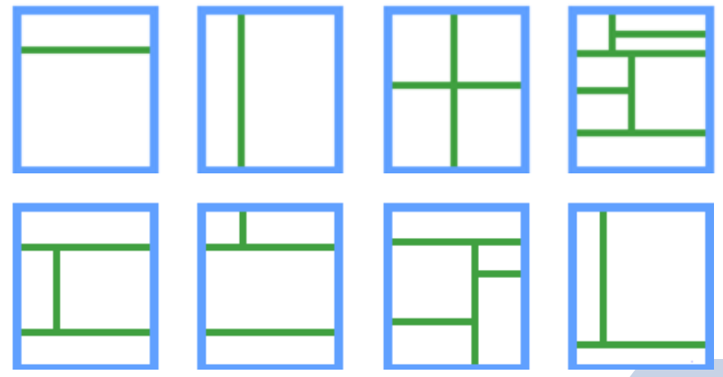
Different Web layout

Slide 5
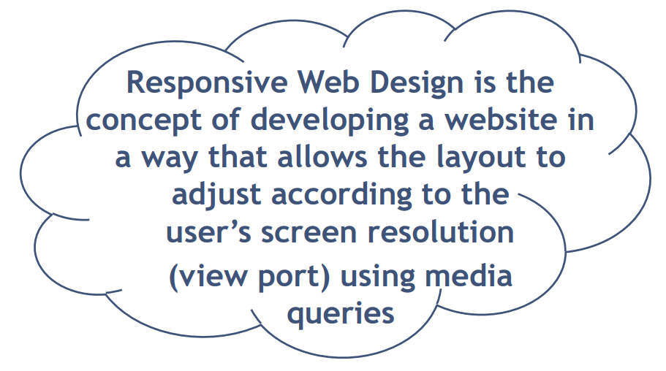

Slide 6
Viewport
Viewport is defined area to display website independent on device screen
Identify and control viewport and its initial scale factor to override useragent
Using meta tag
<meta name="viewport" content="width=device-width, initial-scale=1.0">

Slide 7
Viewport properties
width = device-width
▻ Tells the browser to set the viewport to exact size as the available screen px
initial-scale=1 zoom:1
▻ Control the zoom content of the page
▻ independent on viewport width
▻ Its = 1 when width = device-width
minimum-scale=1 →min-zoom:1
maximum-scale=2 → max-zoom:2
user-scalable=no → user-zoom : fixed

Slide 8
Terminologies
Responsive design is where website isn’t fixed with single size, It responds to users’ device automatically
Adaptive design is where created website redesign itself as per the device size using media query
Negative space is empty space between elements to it more readable
padding or margins are great strategy to create it

Slide 9
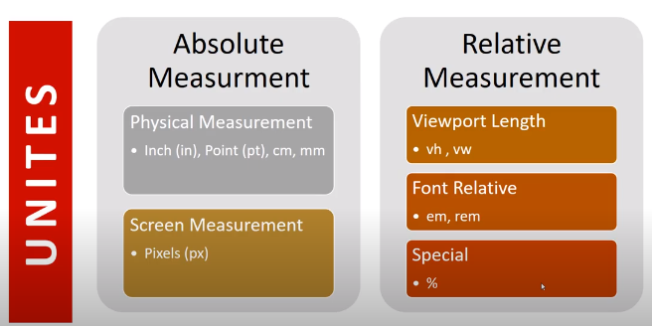

Slide 10
Responsive web design Fundamentals
flexbox
Grid-based layout
Flexible layout
Media Queries
Adapt content to different screen size
Flexible resizable Images & Media
Responding to screen size change
Responsive frameworks “bootstrap”

Slide 11
FlexBox
One dimensional layout model .
Flexible and efficient layouts
Distribute space among items
Control their alignment

Slide 12
Why flexbox
A lot of flexibility
Arrange items
Spacing
Alignment

Slide 13
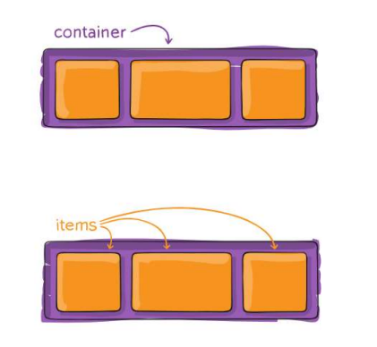
Terminology
Flex container
Flex items

Slide 14
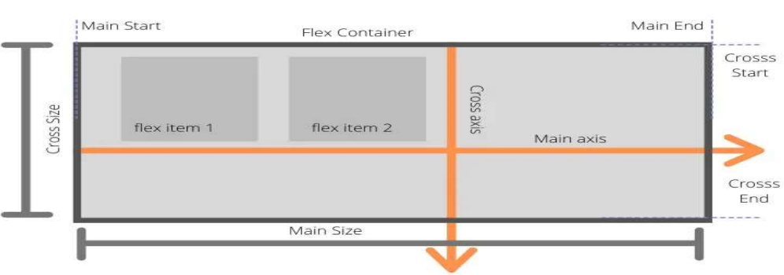
Flexbox Axes 1-Main axis 2-Cross axis

Slide 15
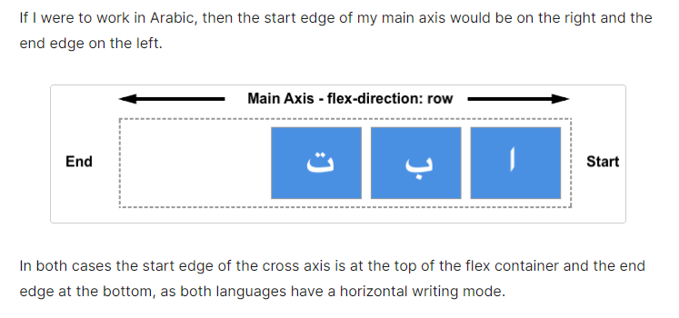

Slide 16
Flexbox container properties
Display
Flex-direction
Flex-wrap
Flex-flow
Justify-content
Align-items
Align-content
gap

Slide 17
Display
Create either a block level or inline level flex container
Flex
Inline-Flex

Slide 18

Flex-direction
Sets the direction of the main axis
Row (default)
row-reverse
Column
Column-reverse

Slide 19

Flex-wrap
Control the wrapping of flex items within the container
nowrap (default)
wrap
wrap-reverse => push the last item above instead of below

Slide 20
Flex-flow
Short hand for flex direction and flex wrap
Flex-flow: {flex-direction}{flex-wrap} default is row nowrap

Slide 21
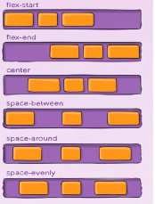
Justify-content
Align items and distribute any extra spacing in the parent container
The alignment is always along the main axis
Flex-start (default)
Flex-end
Center
Space-between
Space-around
Space-evenly

Slide 22
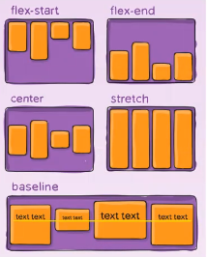
Align-items
Align items along the cross axis
Flex-start
Flex-end
Center
baseline
Stretch (default)

Slide 23
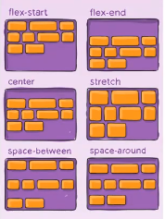
Align-content
Align lines of content along the cross axis and distribute any extra spacing in the parent container
Flex-start
Flex-end
Center
Space-between
Space-around
Stretch (default)

Slide 24
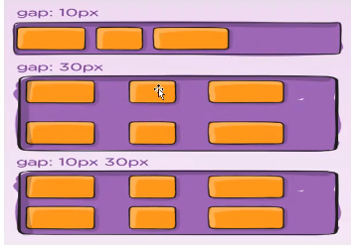
Gap
Spaces between rows & columns

Slide 25
Flex items properties
Order
Flex-grow
Flex-shrink
Flex-basis
Flex
Align-self

Slide 26
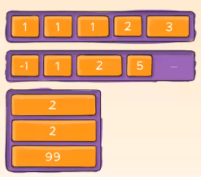
Order
Control the order of items in the flex container
Zero is the default value

Slide 27
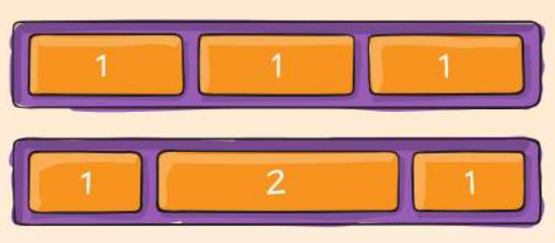
Flex-grow
Dictates what amount of the available space inside the flex container the items should take up. Relative to other items in the container.
Zero is the default value

Slide 28

Flex-Shrink
Dictates the shrink factor of the flex items when the default size of flex items is larger than the flex container .
Relative to other items in the container in case of increasing shrink
Default value is 1 .

Slide 29
Flex-Basis
Set the initial size of flex items.
It accepts pixels , percentages or relative units .

Slide 30
Flex
Shorthand for flex-grow , flex-shrink and flex-basis . Flex : {flex-grow} {flex-shrink} {flex-basis}

Slide 31
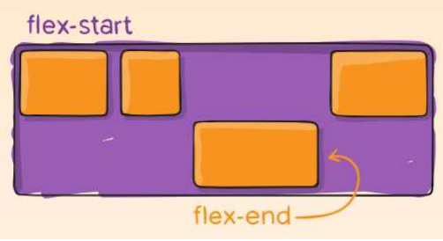
Align-self
Align items individually . Overrides the align-items value of the flex container
Auto
Flex-start
Flex-end
Center
Stretch

Slide 32
Media Queries
Tell the browser how to style an element at particular viewport dimensions
Types :
all
Screen
Print
Speech

Slide 33
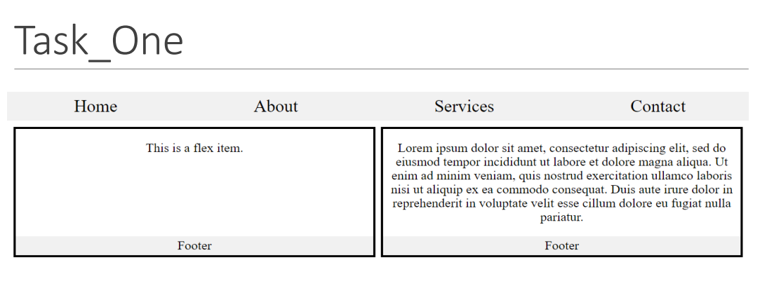

Slide 34
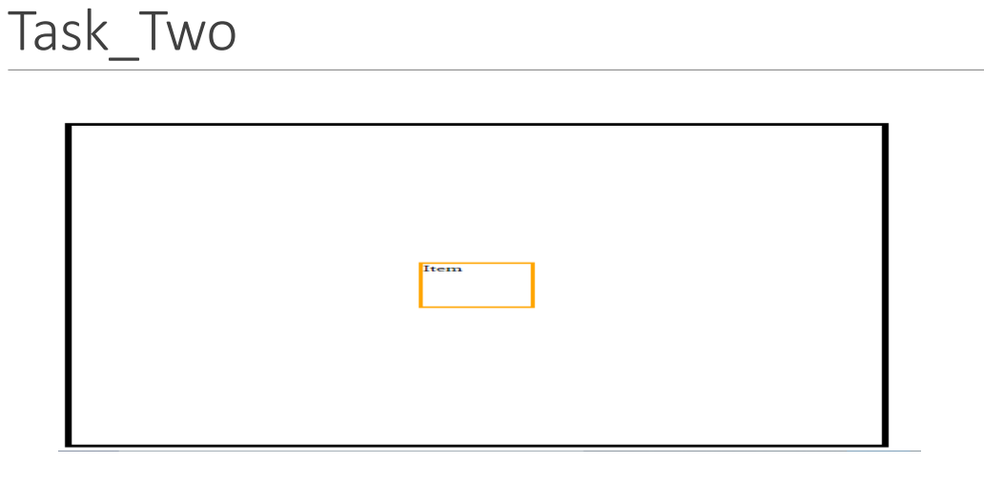

Slide 35
task3
Flexbox Froggy - A game for learning CSS flexbox

Slide 36
links
https://www.youtube.com/watch?v=bI-rUkB6150&list=PLwNCA4TmiKCj9nZE6HzQ7L2BVWSCrlyFV&index=95
https://docs.emmet.io/cheat-sheet/
https://css-tricks.com/snippets/css/a-guide-to-flexbox/
https://flexbox.help/

